Slide 1
Creating a Unique Combat System

Slide 2
At the beginning of the project
What was the research question?
How does the introduction of a distinctive combat mechanic influence player engagement and enjoyment in turn-based games?
What genre will the unique combat system be based on?
What is a unique combat system and give an example?
Paper mario
Baldurs gate 3
What research ended up happening
-Research familiar games like divinity sins ,X com,
Baldur's gate, Final fantasy tactics
-Since there was no scholarly analysis on this
topic, thematic analysis was done to see how
players view turn based systems and why it would be fun
After all this, the development process began. This was split up into four months, the first month the focus was on research further( AI, Pathfinding, damage calculations) and asset design/creation. The second month was on pathfinding and movement, the third month was mechanics such as turn order system, attack mechanics and laying the foundations of both the wheel mechanic and AI. Fourth month was polishing the wheel game and AI and finish writing the report up.

Slide 3
Goals and achievements
What goals did I have to consider completing this project?
Having a functional mechanic
Creating a “Unique Mechanic”
Allowing the mechanic to easily integrate with a game
Ensuring that I have a way to present how the mechanic interacts with a game
Creating the foundations of a turn-based game
A functional AI
Variety of choice for the player

Slide 4
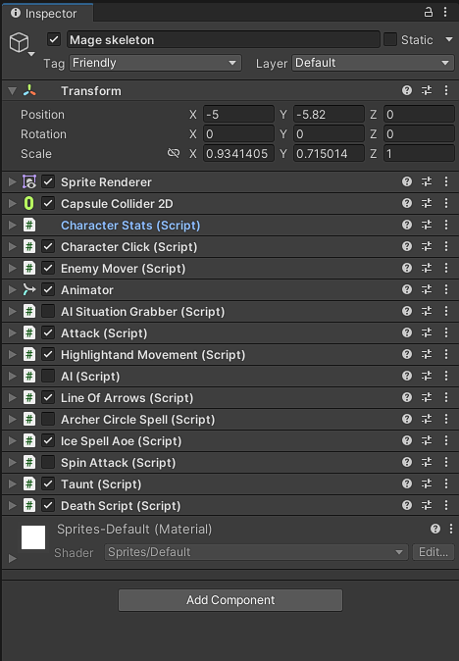
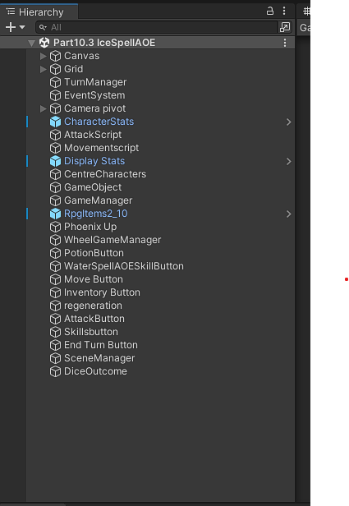
Information you may need to know
What is a game object in unity?
A container which can represent characters or props. It’s a container that doesn’t do anything on its own but can have components(scripts) attached to it that give it properties and behaviours
Game object to the left, hierarchy to the right.

Slide 5
The development process, What was completed:
Creating a cursor
Implementing pathfinding
Creating the wheel mechanic
Allowing players to move characters
Finding a way to create and store character stats
Visualising the character stats
Creating an attack mechanic (how the damage calculation would work)
Creating a turn order system
Creating an inventory panel (UI)
Creating items for the inventory panel
Integrating items with the wheel mechanic
Implementing class specific skills
Integrating those skills with the wheel mechanic
Creating an AI
How will the AI make decisions( Dual utility system)
How will the AI know what tile to move to (AI Situation grabber)
creating methods to allow the AI utilise skills.
Create a way to simulate the AI playing the wheel game (roll dice)

Slide 6
Pathfinding
What does GetReachableTiles do?
The GetReachableTiles method identifies all the tiles on a game grid that a character can move to within a specified distance (or range) from a starting tile position.
How does it achieve this?
Initialization: It begins by setting up two key structures:
A reachableTiles set to keep track of all the tiles that can be reached.
A queue to keep track of tiles that need to be checked.
Starting Point: It adds the starting tile position to the queue with a distance of 0.
Tile Exploration:
As long as there are tiles in the queue to explore, it checks each tile.
For each tile, if its distance from the starting point is less than the specified range, the method will:
Get all neighboring tiles around it.
Check each neighboring tile to see if it's walkable (i.e., can the character move there?).
If the neighboring tile is walkable and hasn't been added to the reachableTiles set, it's added both to the set and to the queue to check its neighbors in subsequent iterations.
Result:
Once all possible tiles within the given range have been explored, the method returns the reachableTiles set, which contains all tiles the character can move to.
In simple terms: Imagine you're at the center of a pond and you throw a stone. The ripples it creates move outward. The GetReachableTiles method works similarly. It starts at a point and moves outward to all accessible neighboring tiles, marking them as reachable until the specified range is covered.

Slide 7
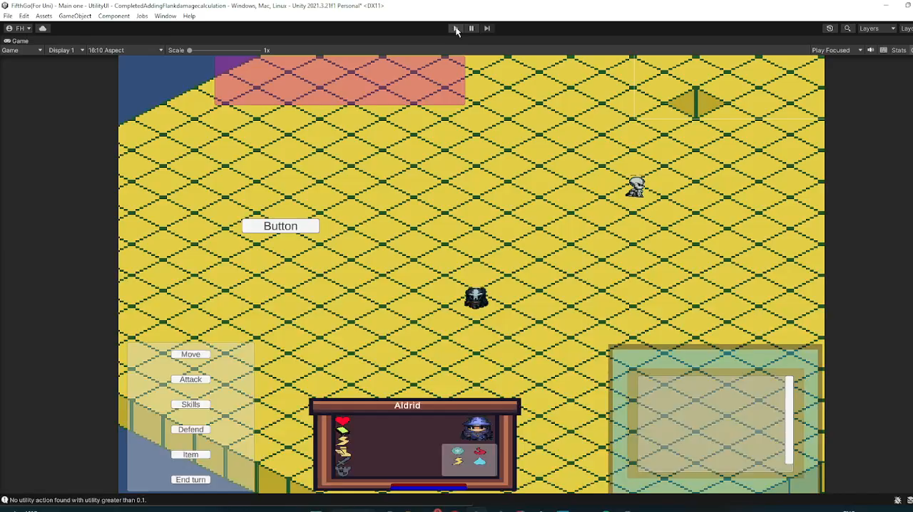
Warrior AI

Slide 8

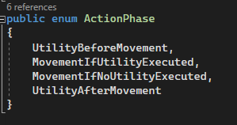
Archer AI

Slide 9
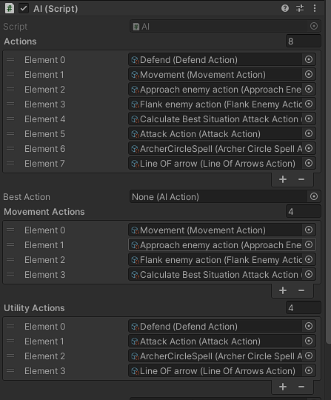
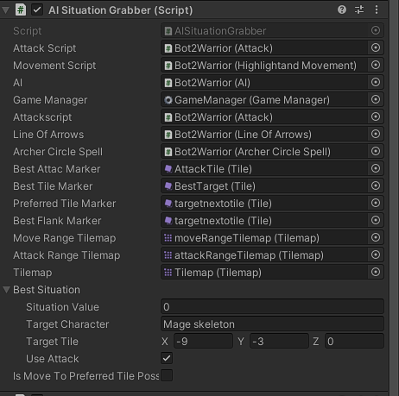
How the AI class looks at runtime in the inspector
How the AISituationGrabber class looks at runtime in the inspector

Slide 10
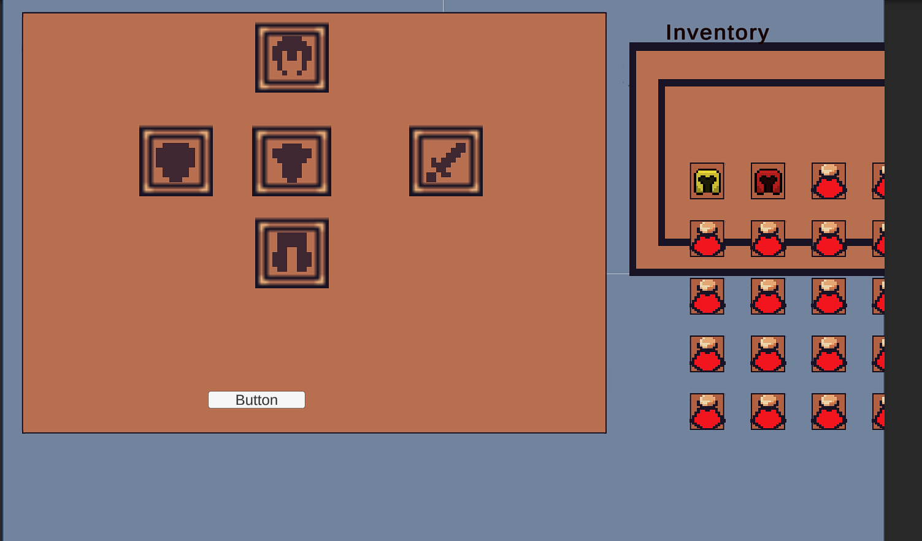
Additional feature:Armour system

Slide 11
Any questions?

